Slide 1
Governance of Analytics Models

Slide 2
Governance of analytic/AI models provides benefits
Reduce effort/cost in building valuable analytics models.
Increased confidence in resulting recommendations.[explainability]
Avoidance of rework and the development of undeployable analytics.
Faster time to value and lower cost in production.
Smoother path to business adoption.
[compliance – eg risk decision not based on non-compliant info]

Slide 3
Data science development process
Many data scientists are trained at university to use a variety of their own tools and download data as they need from the internet and other unsecured sites.
There can be resistance to changing this mode of operating when they transition to the workforce.
Little formality is needed for experimentation with public data and to provide ad hoc answers to low risk questions.
However, for many organizations:
Their data is sensitive (personal or commercial)
The results of data science will impact the business’s operation (this is the point of it ☺ )
The organization needs to demonstrate that it is compliant with regulations and the data’s licenses.
Organizations need to govern data science processes to have assurance that the analytical models are accurate and ethical for their business.

Slide 4
Real-time analytics lifecycle (simplified)
Exploration
Deployment
Discovery
Locate Data
Build Analytic Models
Run Analytic Models
4

Slide 5
Questions arising
How is data sourced?
What processes and checks do the data scientists use?
How is data located and evaluated?
Exploration
Deployment
Discovery
Are external models used?
How are requirements described?
Are models shared for reuse?
Locate Data
Build Analytic Models
How is the model evaluated before further development?
What feedback is passed to the data science team?
How is the solution built around model?
Run Analytic Models
How is the model evaluated in production?
5

Slide 6
Describing requirements for Analytics/AI
Requirements definition provides the foundation for good data science. This includes:
Understanding the question that is being asked and how the results will be used. This helps define the scope of data needed and other factors such as its precision and timeliness.
Understanding of the expected deployment environment. For example, a model for real-time use needs to be built on data that is available in the real-time environment for it to be practical. Ad hoc, one-time use models may employ data from a wider range of sources and involve more cleansing/combining of the data.
Requirements may not be fully understood at the start of the project. They will typically be refined as the data scientists work with data to explore the art of the possible.

Slide 7



Iterative requirements refinement
Callie Quartile
Data Scientist
Business Stakeholder
discussion
Experimentation
Faith Broker
Human Resources

Slide 8
How is data located and evaluated?
Many data science projects are delayed looking for data.
Comprehensive data catalogs speed this up and:
Ensure all data sources are considered.
Simplify evaluation of whether the data is appropriate to the question being asked.
Provide a reference to show which data was used to train the model.
Improve confidence in resulting model since lineage of training data is understood.
The more projects that use the same data sources, the more they form into a comprehensive program that collectively inspires confidence.
This is in addition to the savings in data engineering that comes from the shared use of data sources.

Slide 9
How is data sourced?
Data scientists need to work from a copy of data so their manipulation of it does not disrupt production data. The place where this copy is stored is often called a sandbox.
Data should come from official sources through a managed pipeline that considers:
Terms and conditions and other legal aspects.
Cataloguing the copies of data made.
Location of sensitive data and any protection mechanisms that are needed.
Mechanisms to refresh the data.
Mechanism to destroy/archive the data at the end of the project.
Data will need to be split into training set and test / validation set.

Slide 10
What processes and checks do the data scientists use?
The model development process needs to create an audit trail showing the data sources used, the transformations made to the data – including corrections, the testing that was performed and the transformations made to the results.
This can be done informally using, for example, python notebooks, to show how the model was created and tested.
Alternatively, mechanisms that automatically create a trace of the data scientist at work could be used.
It may be necessary to catalog and archive all of the data sets involved in the model development process.
Models should be managed like software in source code repositories.

Slide 11
Are external models used?
There are an increasing number of catalogs of models available on the internet. Many are open source and free to use.
The organization needs to create guidelines on the use of external models along similar lines to the use of open source software to ensure
Licenses (remembering the license of any dependent libraries) allow commercial use.
The model operates correctly within the scope needed by the organization.
The model does not introduce any vulnerabilities.

Slide 12
Are models shared for reuse?
Just as data is shared, an organization could consider having a catalog of analytical models that its data scientist can use.
The catalog needs to define each models behavior including the scope of data it was trained with and exemplars that illustrate where it works well and where it fails.

Slide 13
How is the model evaluated before further development?
Data scientists typically perform many experiments before a break-through is achieved. Some models are to answer an ad hoc question and can be run in the sandbox.
Some models promise to deliver ongoing business value if they are operationalized.
Evaluation of which models to invest in further include:
Is the business value sufficient to justify the investment?
What would the cost to turn the model into a business service?
What would be the cost of deployment:
Retraining of staff
Changes to organization and roles
Changes to existing systems
What would be the savings?
How long will this model be effective?
Does this processing of data comply with license and consent associated with it?
Would this processing of data damage the brand of the organization if it were known to the public/customers/business partners?

Slide 14
How is the solution built around model?
Once an analytical model seems to produce the types of results that the business stakeholders are looking for, it needs to be developed into a solution.
The solution development process is similar to other software solution processes with additional focus on:
Data engineering to bring data to the model and route the results to where they are needed.
Monitoring to ensure the profile of data feeding the model is not drifting away from the original training set.
Reporting back to the data science team on the efficacy of the model in production.
Scale up and operationalization from an availability pov (eg lump of python may not scale)

Slide 15
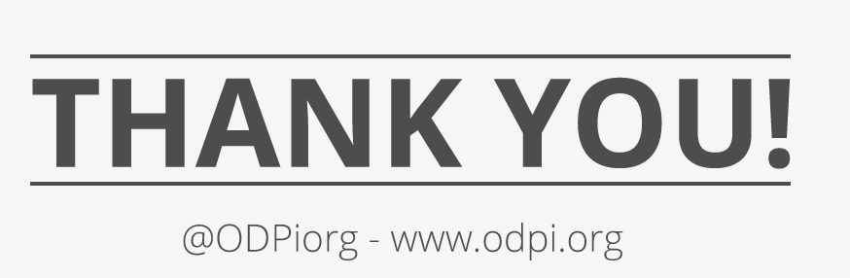
15

